Slide 1
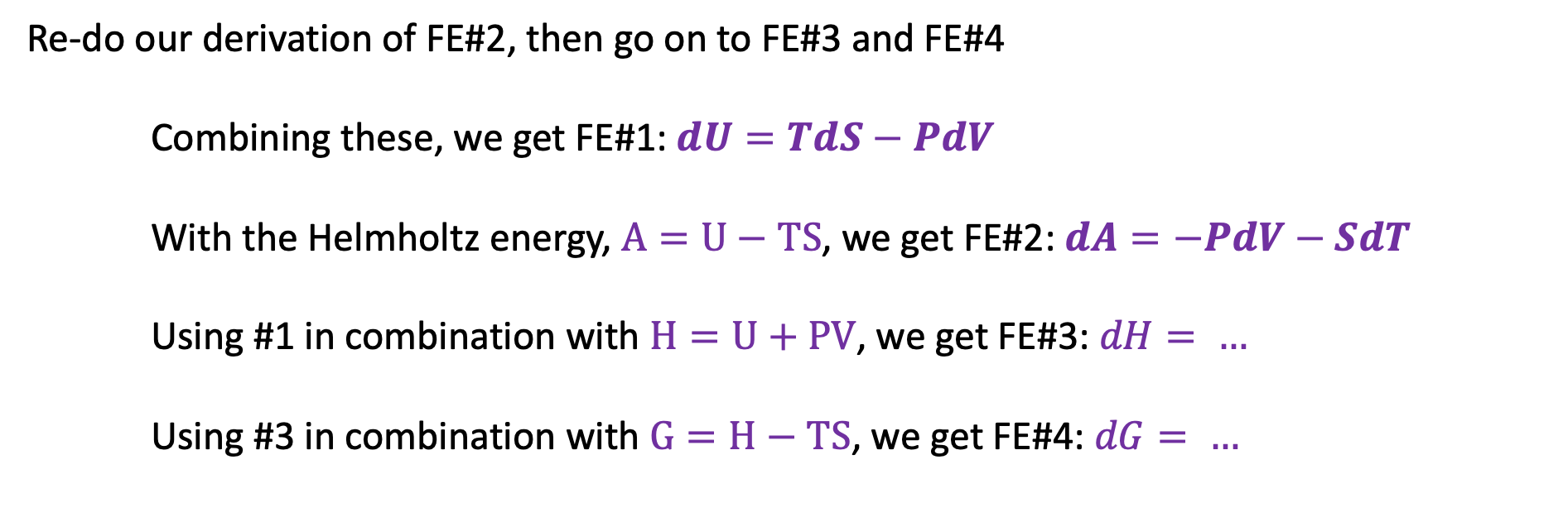
Deriving FE#3 and FE#4
Re-do our derivation of FE#2, then go on to FE#3 and FE#4
Combining these, we get FE#1: $dU=TdS−PdV$
With the Helmholtz energy, $A=U−TS$, we get FE#2: $dA=−PdV−SdT$
Using #1 in combination with $H=U+PV$, we get FE#3: $dH= …$
Using #3 in combination with $G=H−TS$, we get FE#4: $dG= …$

Slide 2
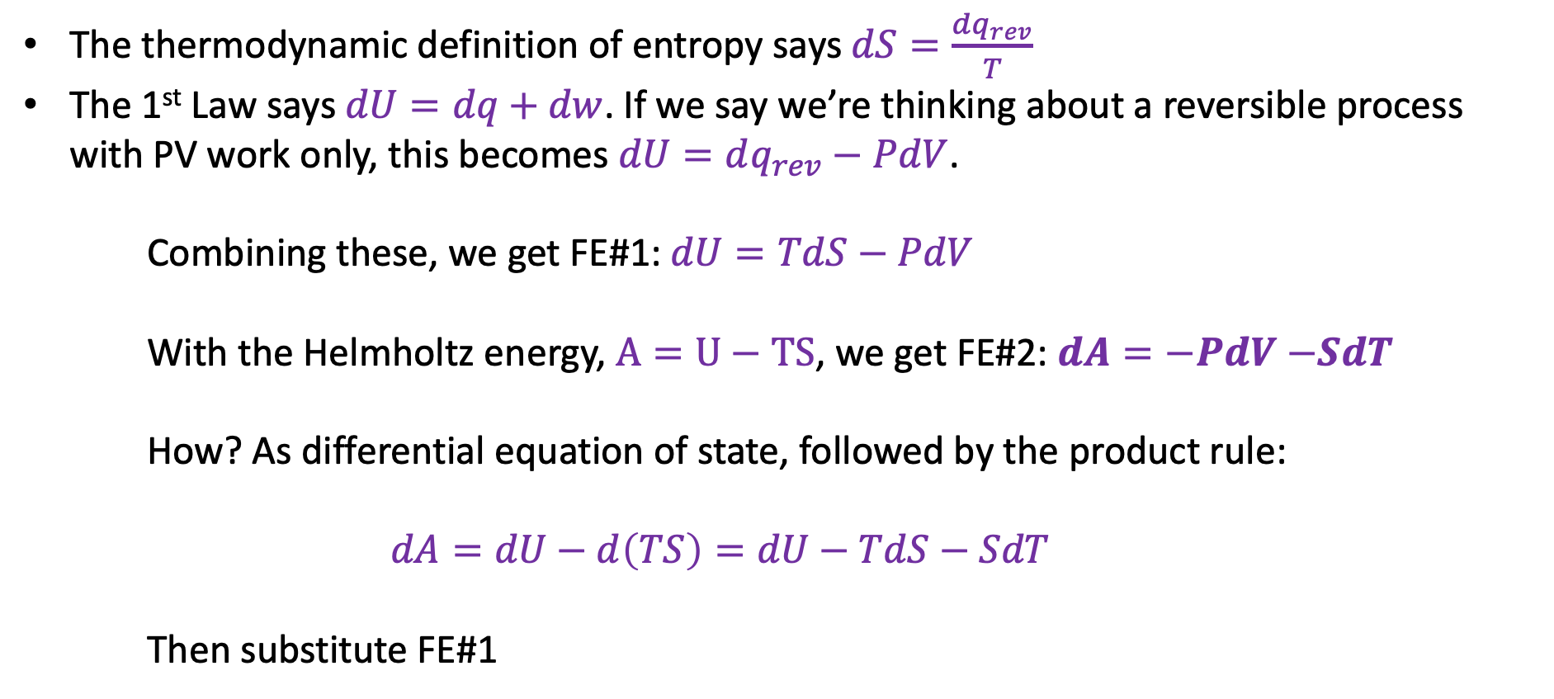
II. Four “Fundamental Equations” of Thermodynamics
The thermodynamic definition of entropy says $dS=\frac{dq_{rev}}{T}$
The 1st Law says $dU=dq+dw$. If we say we’re thinking about a reversible process with PV work only, this becomes $dU=dq_{rev}−PdV$.
Combining these, we get FE#1: $dU=TdS−PdV$
With the Helmholtz energy, $A=U−TS$, we get FE#2: $dA=−PdV$ $−SdT$
How? As differential equation of state, followed by the product rule:
$$dA=dU−d\left(TS\right)=dU−TdS−SdT$$
Then substitute FE#1

Slide 3

II. Four “Fundamental Equations” of Thermodynamics
The thermodynamic definition of entropy says $dS=\frac{dq_{rev}}{T}$
The 1st Law says $dU=dq+dw$. If we say we’re thinking about a reversible process with PV work only, this becomes $dU=dq_{rev}−PdV$.
Combining these, we get FE#1: $dU=TdS−PdV$
With the Helmholtz energy, $A=U−TS$, we get FE#2: $dA=−PdV$ $−SdT$
How? As differential equation of state, followed by the product rule:
$$dA=dU−d\left(TS\right)=dU−TdS−SdT$$
Then substitute FE#1
$TdS$ terms cancel

Slide 4
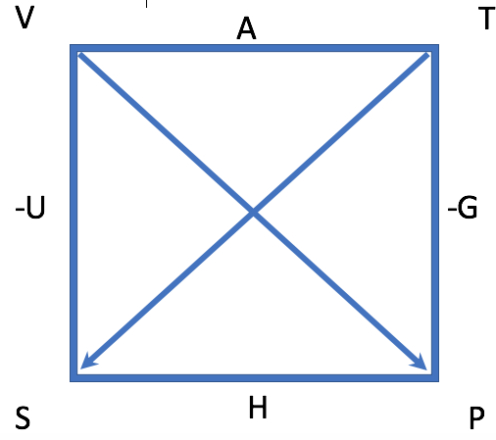
II. Four “Fundamental Equations” of Thermodynamics
The thermodynamic definition of entropy says $dS=\frac{dq_{rev}}{T}$
The 1st Law says $dU=dq+dw$. If we say we’re thinking about a reversible process with PV work only, this becomes $dU=dq_{rev}−PdV$.
Combining these, we get FE#1: $dU=TdS−PdV$
With the Helmholtz energy, $A=U−TS$, we get FE#2: $dA=−PdV$ $−SdT$
How? As differential equation of state, followed by the product rule:
$$dA=dU−d\left(TS\right)=dU−TdS−SdT$$
Then substitute FE#1
$TdS$ terms cancel

Slide 5

II. Four “Fundamental Equations” of Thermodynamics
Your task: Re-do our derivation of FE#2, then go on to FE#3 and FE#4
Combining these, we get FE#1: $dU=TdS−PdV$
With the Helmholtz energy, $A=U−TS$, we get FE#2: $dA=−PdV−SdT$
Using #1 in combination with $H=U+PV$, we get FE#3: $dH= …$
Using #3 in combination with $G=H−TS$, we get FE#4: $dG= …$

Slide 6
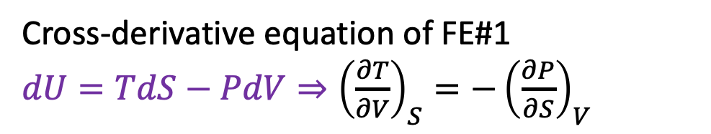
Cross-derivatives of the Fundamental Equations are the arms-around
Cross-derivative equation of FE#1
$dU=TdS−PdV⇒{\left(\frac{∂T}{∂V}\right)}_{S}=−{\left(\frac{∂P}{∂S}\right)}_{V}$

Slide 7
Cross-derivatives of the Fundamental Equations are the arms-around
Cross-derivative equation of FE#1
$dU=TdS−PdV⇒{\left(\frac{∂T}{∂V}\right)}_{S}=−{\left(\frac{∂P}{∂S}\right)}_{V}$
This agrees with the box!

Slide 8
Cross-derivatives of the Fundamental Equations are the arms-around
Cross-derivative equation of FE#1
$dU=TdS−PdV⇒{\left(\frac{∂T}{∂V}\right)}_{S}=−{\left(\frac{∂P}{∂S}\right)}_{V}$
This agrees with the box!
This is called a Maxwell Relation

Slide 9
Cross-derivatives of the Fundamental Equations are the arms-around
Cross-derivative equation of FE#1
$dU=TdS−PdV⇒{\left(\frac{∂T}{∂V}\right)}_{S}=−{\left(\frac{∂P}{∂S}\right)}_{V}$
This agrees with the box!
This is called a Maxwell Relation
Your task: Show that Maxwell Relations derived from cross-derivatives of FE#2 – FE#4 agree with the box

